Slide 1
Keep it SMPL: Automatic Estimation of 3D Human Pose and Shape from a Single Image
2018.05.03
Jae-Ryun Chung

Slide 2
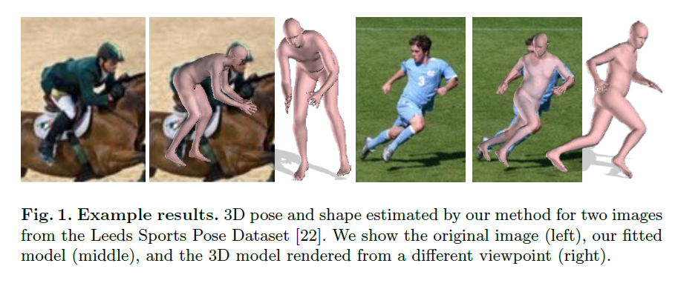
Abstract
Estimate 3D pose and shape from a single unconstrained image
Problems : complexity of body, articulation, occlusion, clothing, lighting,…
Solve :
  (bottom-up) DeepCut – CNN based method predict 2D body joint locations
  (top-down) fit SMPL, statistical body shape model, to 2D joints

Slide 3
Introduction
Prev. approaches focus only on pose
Key contributions
  Proposed method is fully automatic estimating both pose and shape
  Interpenetration term
    differentiable with respect to shape and pose
    Define a set of”capsules” for body shape
  Define objective function and optimize pose and shape
Insist 2D joint locations contain 3D shape information
Gender-specific
  Know gender – use specific model (pink model)
  Don’t know – use neutral model (light blue model)

Slide 4
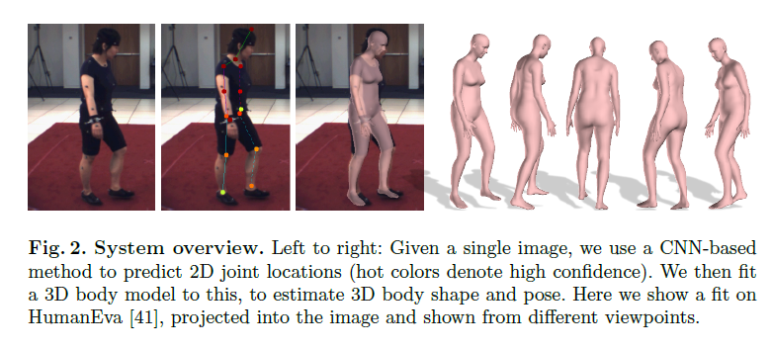
Method
DeepCut predict 2D body joints – provide confidence value
Fit 3D body model minimize weighted error term using SMPL
=
  Body model function

Slide 5
Method
=
  Body model function – triangulated surface with 6890 vertices
  β : shape – coefficients of low-dimensional shape space
    3 shape models – male, female, gender-neutral
      Trained gender-neutral using 2000+2000 body shapes used to train SMPL
  θ : pose
    Skeleton rig with 23 joints
    Represent axis-angle of relative rotation
    In SMPL, joints are linear combinations of surface vertices or function of shape coefficients
    R_{θ}(J(β)_{i}) for joint i, R_{θ} is global rigid transformation induced by pose
  : transation

Slide 6
Method
Approximating bodies with capsules
In graphics, use proxy geometries to compute collisions
  Follow this approach
  Each capsule has a radius and axis length
Capsule
  Train regressor from model shape parameters to capsule parameters
    Pose capsules according to R_{θ}
    Rotation induced by kinematic chain
  20 capsules excluding fingers and toes
  Gradient-based optimization of radii and lengths
  Learn a linear regressor using cross-validated ridge regression
  Precedure iterated once more so initialize capsules with output

Slide 7
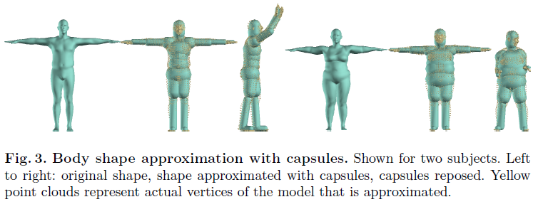
Method
Capsule
  Train regressor from model shape parameters to capsule parameters
    Pose capsules according to R_{θ}
    Rotation induced by kinematic chain
  20 capsules excluding fingers and toes
  Gradient-based optimization of radii and lengths
  Learn a linear regressor using cross-validated ridge regression
  Precedure iterated once more so initialize capsules with output

Slide 8

Objective function
To fit 3D pose and shape to CNN-detected 2D joints
Sum of 5 error terms
  Joint-based data, 3 pose priors and a shape prior
E(β, θ) =
  K : camera parameters
Df
  Penalize weighted 2D distance between joints J and corresponding SMPL joints
  Π_{K} : projection from 3D to 2D by K
  Weight contribution of each joints by confidence of its estimate, ω_{i}, provided by the CNN

Slide 9

Objective function
E(β, θ) =
d
  Pose prior penaizing elbows and knees
  i : sums over pose parameters(rotations) to blending of knees and elbows
  θ_{i} is zero if joint is not bent

Slide 10
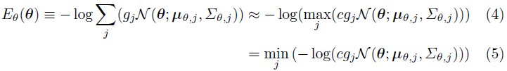
Objective function
E(β, θ) =
d
  Pose prior penaizing elbows and knees
  3D pose estimation
  Use CMU dataset like prev. methods to train pose prior
  Fitting SMPL to CMU marker data using MoSh
  Then fit mixture of Gaussians to 1m poses, spanning 100 subjects
  g_{i} : N = 8 Gaussians
  C : positive constant for our solver implementation

Slide 11


Objective function
E(β, θ) =
d
  “Incompatible” - capsules not intersect in natural poses
  Interpenetration error term that exploits capsule approximation
  Relate error term to intersection volume between incompatible
  Volume of capsule is not simple – Sphere with centers C(θ, β)
  Penalty term inspired by mixture of 3D Gaussians model
    3D isotropic Gaussian with
  I(i) : spheres incompatible with i

Slide 12


Objective function
E(β, θ) =
d
  Shape prior
  $∑$⁻¹_{β} : diagonal matrix with squared singular values via Principal Component Analysis from shapes in SMPL training set
  Shape coefficients β are zero-mean

Slide 13
Optimization
Estimating camera translation
  Only focal length or its rough estimate is known – do not optimize
  Initialize camera translation by assuming person is standing parallel to the image plane
    Estimate depth via ratio of similar triangles defined by torso length of mean SMPL shape and predicted joints
    Minimizing E_{J} and keep β fixed to mean shape during optimization
Fit the model by minimizing Eq.(1)
  Starting high values for λ_{θ} and λ_{β} decrease them is effective to avoid local minima
Side view
  2 initializations - 2D distance between shoulder joints below threshold
  Body orientation above and 180 degree rotated – lowest E_{J}
Takes less than 1 minute on common desktop machine

Slide 14
Evaluation
Evaluate 3D pose – 2 publicly available datasets
  HumanEva-I
  Human3.6M
Both are limited
More challenging data from Leeds Sports Dataset
  Evaluating quantitatively is harder
  Using synthetic data
10 body shape coefficients for all experiments
Tune λ_{i} weights in Eq.(1) on HumanEva and use values for all other experiments

Slide 15
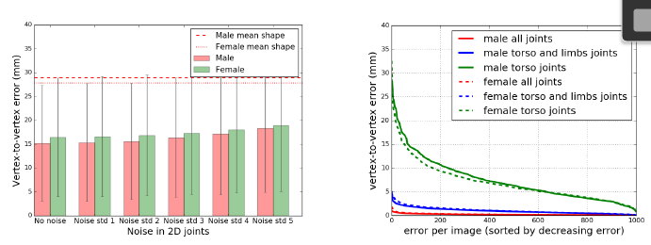
Evaluation - Quantitative
Synthetic Data
  Sample synthetic bodies from SMPL shape and pose space
  Project joints into the image with known camera
  1k images for each male and female(2k total), 640 * 480
  1st experiment
    Add varying amounts of i.i.d. Gaussian noise(std 1 – 5) to each 2D joint
    Left chart – mean vert-to-vert Euclidean error in canonical pose

Slide 16
Evaluation - Quantitative
Synthetic Data
  2nd experiment
    Assume pose is known
    Fit SMPL to ground-truth 2D joints by minimizing Eq.(2) – full 23 joints
    Right chart – mean vert-to-vert Euclidean error in canonical pose
    More joints we have, better body shape is estimated

Slide 17
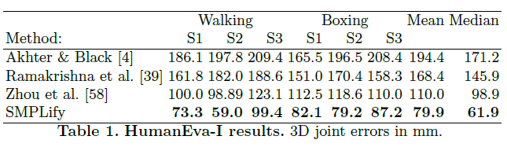
Evaluation - Quantitative
Real Data
  HumanEva-I
    Assume gender is known and apply gender-specific SMPL models
    Other methods train sequence-specific pose prior for HumanEva
    Unlike them, We tune weights on training set and learn a mapping from joints to skeletal representation
    Input: 2D joints from DeepCut
      DeepCut is trained on different dataset

Slide 18
Evaluation - Quantitative
Real Data
  HumanEva-I
    SMPLify is conceptually simpler and more accurate then Zhou et al. [58]
    SMPLify not only “lift” 2D joints to 3D, but produces skinned vertex-based body model

Slide 19
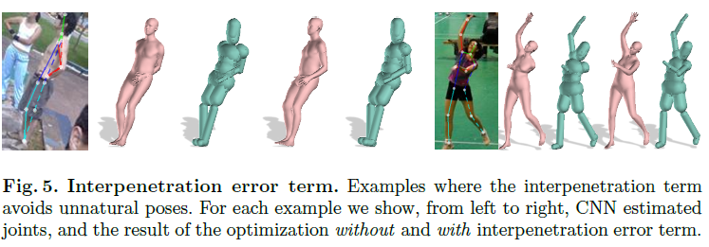
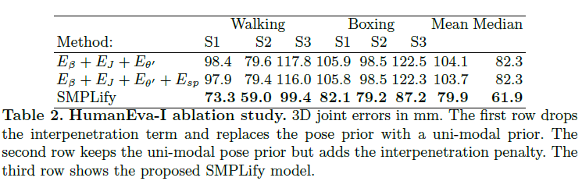
Evaluation - Quantitative
Real Data
  HumanEva-I
    To gain insight about method(Table2)
      E_{θ}’ : use single Gaussian trained from same data
      Add interpenetration term
        Does not have significant impact on 3D joint error
        BUT, qualitatively, it makes difference in more complex datasets with varied posed and viewing angles as Fig.5

Slide 20
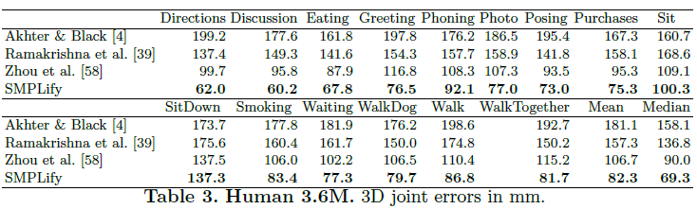
Evaluation - Quantitative
Real Data
  Human3.6M
    Wider range of poses
    Perfrom same analysis
    Focal length and distortion coefficients are known since subjects are closer to borders of image

Slide 21
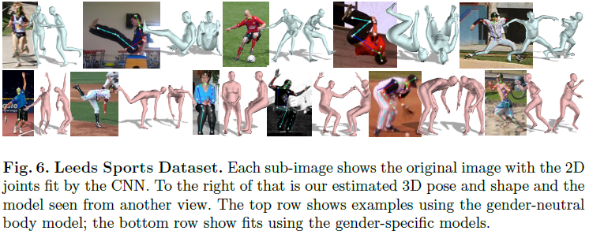
Evaluation - Qualitative
Leeds Sprts Pose dataset
  More complex in terms of pose, image resolution, clothing,...
  Fig.6 some examples where system works well
  Gender labeled for gender-specific models

Slide 22
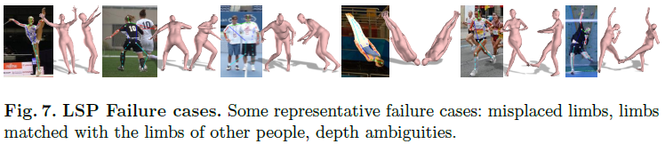
Evaluation - Qualitative
Leeds Sprts Pose dataset
  Failures

Slide 23
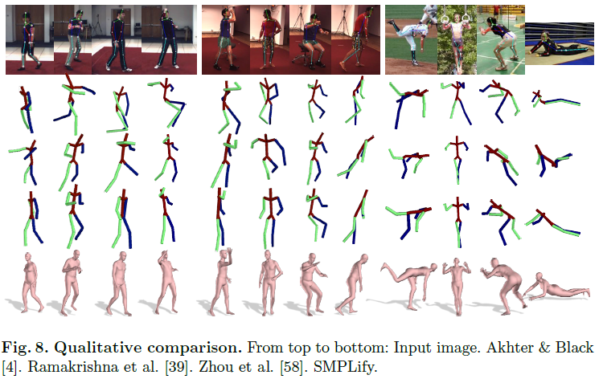
Evaluation - Qualitative
Leeds Sprts Pose dataset
  Visually compares results

Slide 24
Conclusion
SMPLify is a fully automated method for estimate 3D body shape and pose from 2D joints
We define objective function and optimize pose and shape directly by minimizing error
Simple, yet effective
Our formulation opens many directions for future work
Cues such as silhouettes
Use multiple camera and frames
Facial pose detector, gender detector
Train CNN to predict features directly related to 3D shape

